Slide 1

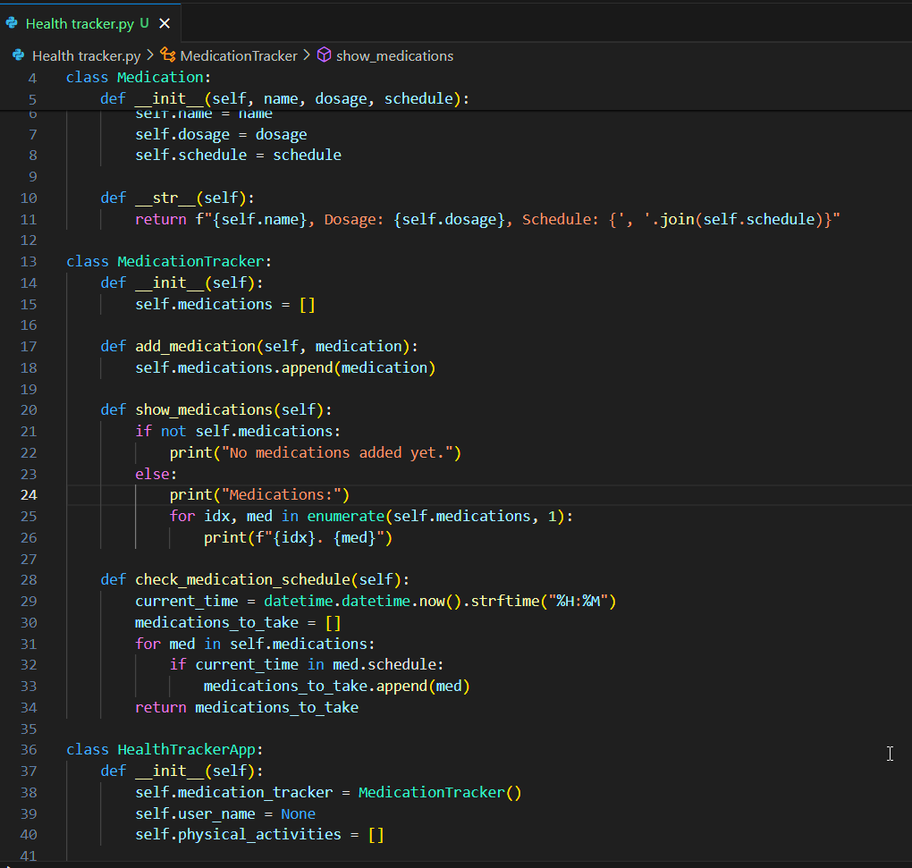
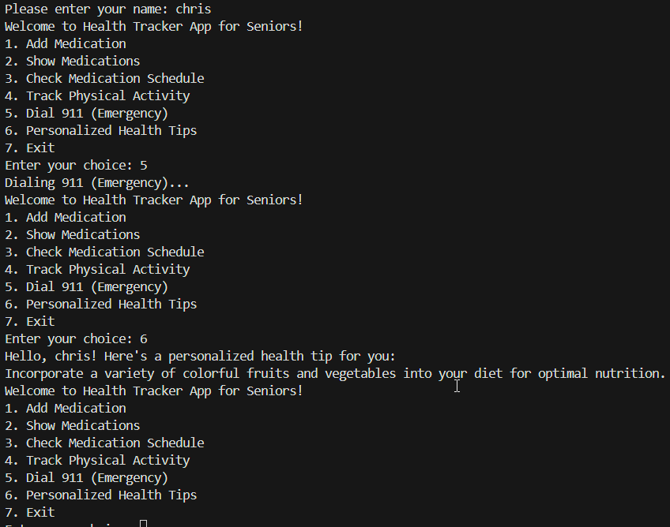

"Empowering Seniors to Prioritize Their Health"
Health Tracker App for Seniors
Addressing Unique Health Management Needs for Older Adults
User-friendly platform integrating:
Medication Schedule Tracking
Vital Signs Monitoring
Appointment Management
Physical Activity Tracking
Emergency Assistance
Medical Tips
https://github.com/ksu-is/Health-and-Initiative-Tracker/commit/eba6ffdab9f5e3219031c2ee495417c39895b6bb
By Christian Egboh

